Slide 1






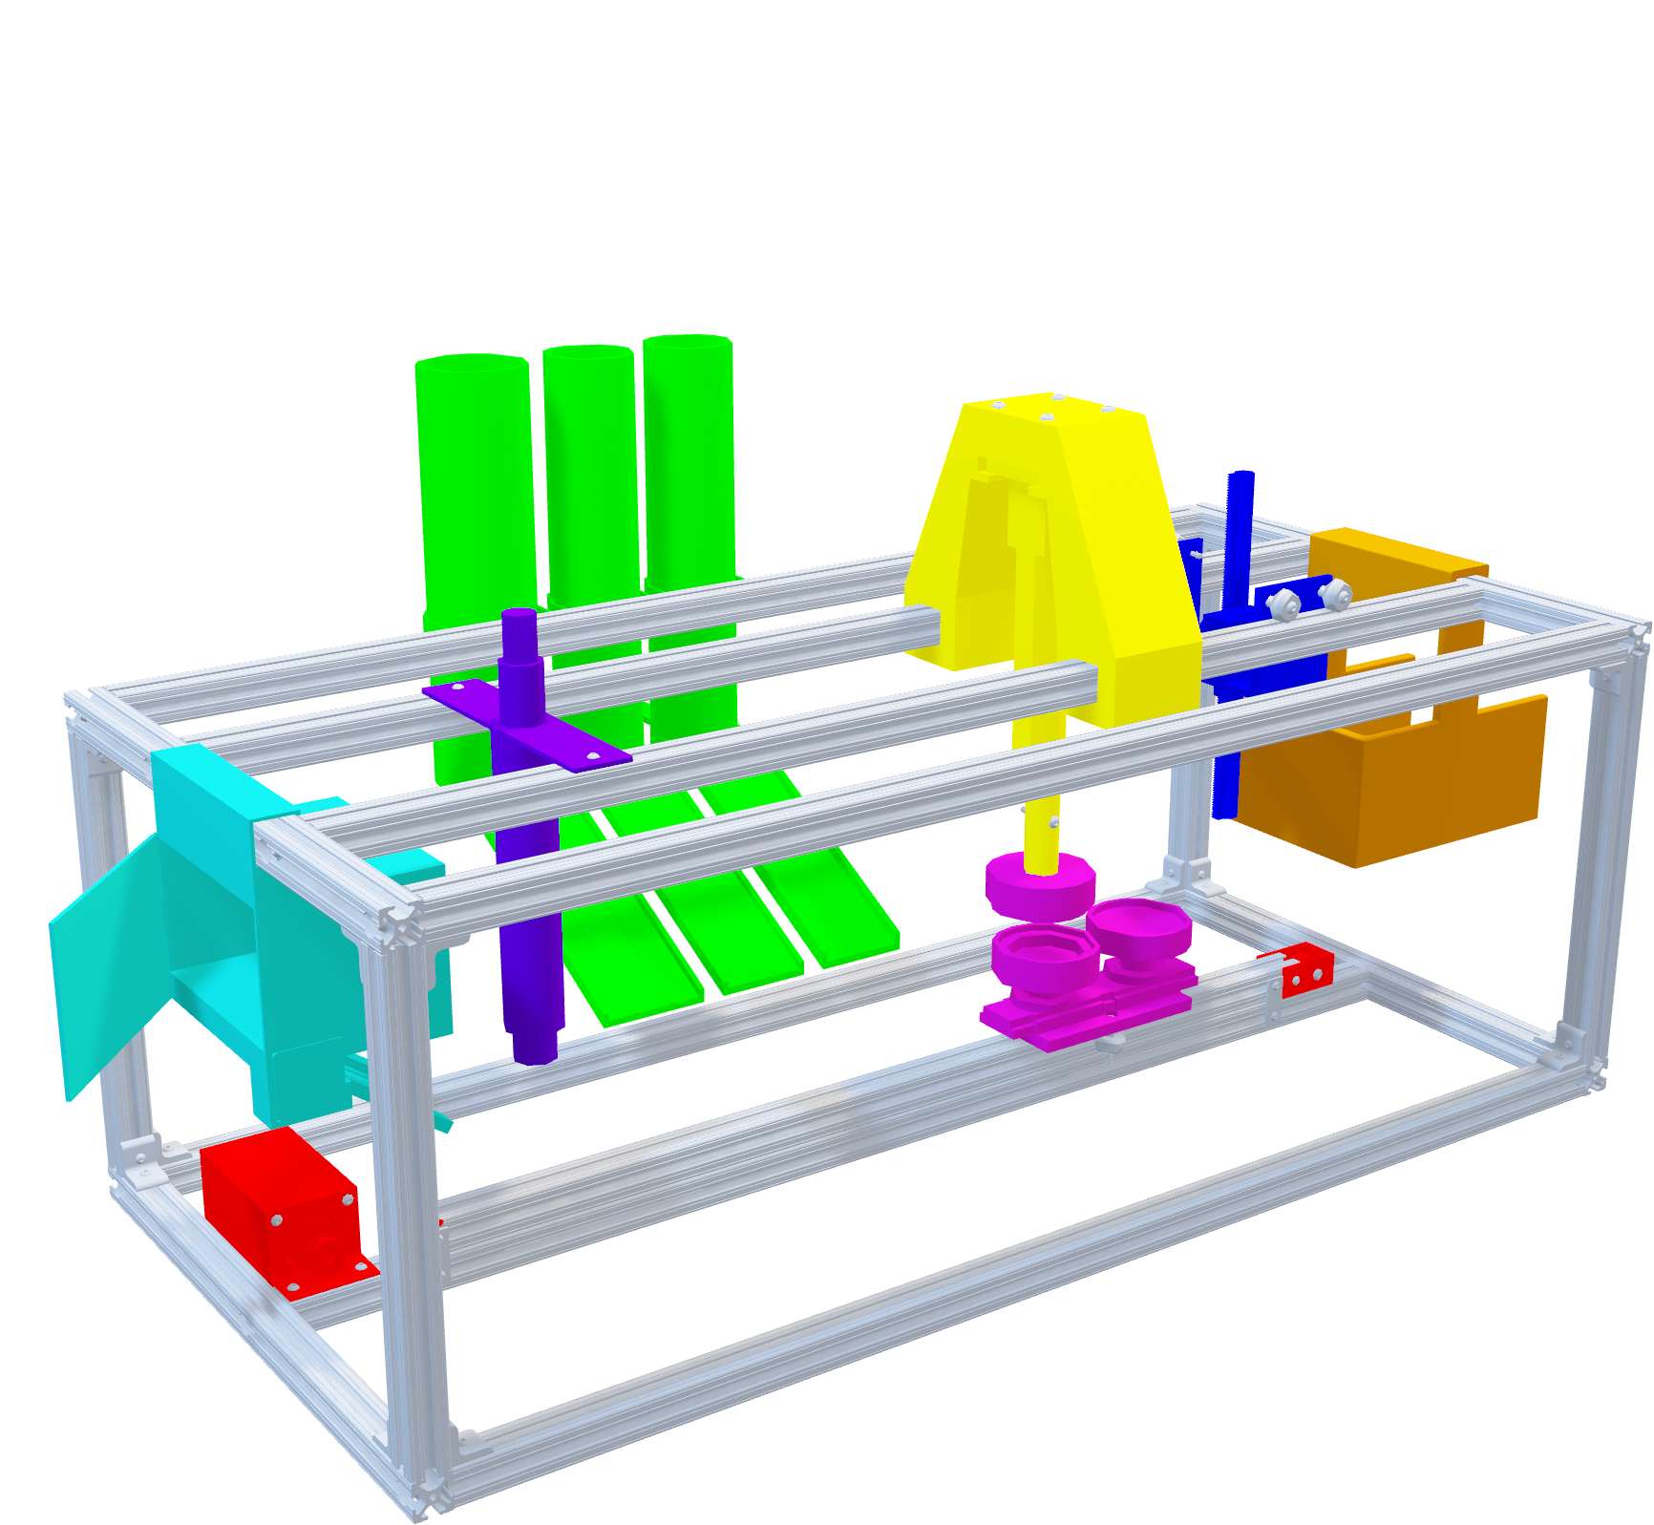
Team 522: Rockwell Automation Manufacturing Device for Students
Luis Garcia, Chloe Keiran, Caleb Mears, Maria Rojas, Caden Schwartz
The objective of this project is to create a system that can demonstrate the automated manufacturing process and create an educational item
Key Goals
Design Selected
Functional Decomposition
Display the manufacturing process
Provide an educational experience
Distribution of a tangible educational product
Metal pin with Rockwell branding
ROCKWELL AUTOMATED LEARNING TOOL
PIN TOP
PIN BOTTOM
CONTROL
SUPPORT
EDUCATE
MANUFACTURE
CUSTOM DESIGN
Customer Needs
Future Work
Under 30 pounds
Use Rockwell hardware/software
Engage all ages
Safe
Product with Rockwell branding
Consult with Sponsors About Future Design Improvement
Implement Fully
Automated System
Further Testing & Risk Analysis
POWER SUPPLY 1
POWER SUPPLY 2
SM 1
SM2
SM 3
1
SM 5
MOTOR CONTROLLER
MCU
3 LIGHTED
PUSH BUTTONS
MOTOR
CONTROLLER
1
SM 4

